Slide 1
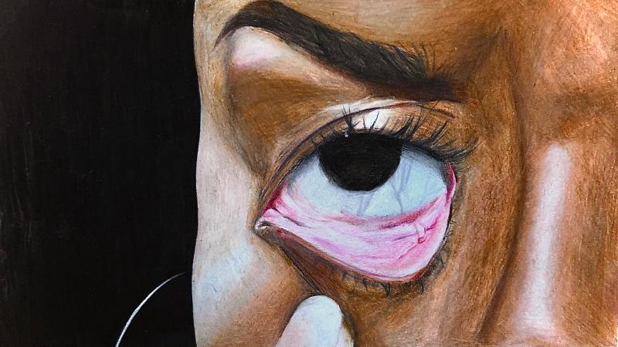
Eryka Sterling
Wilde Lake High School

Slide 2
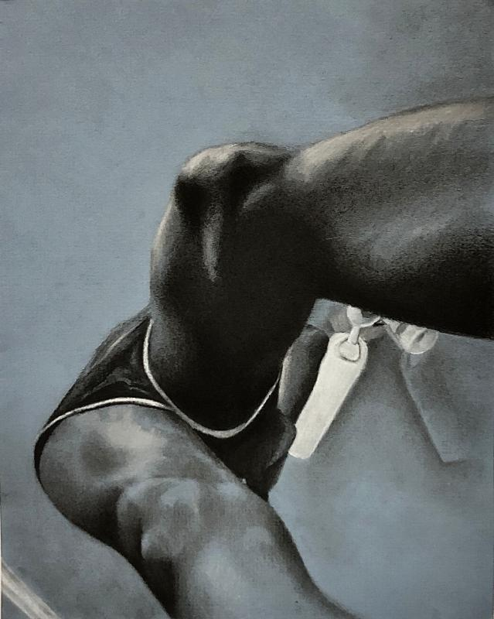
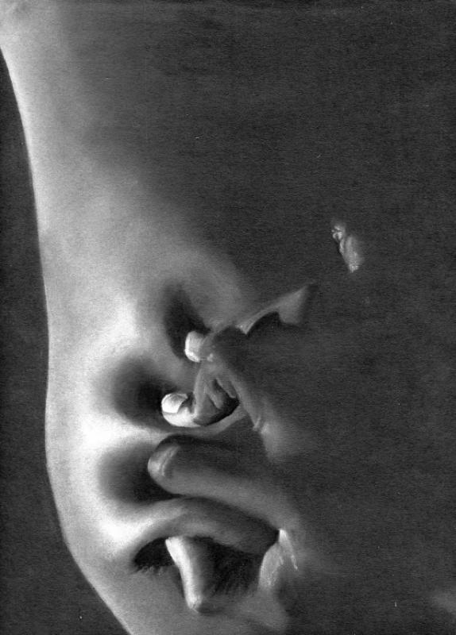
The human body can be perceived as anything to anyone and I want to evoke that same thought when looking at my artwork. I decided to investigate the capabilities of the human body by exploring all that they can do and examine all different body types.

Slide 3
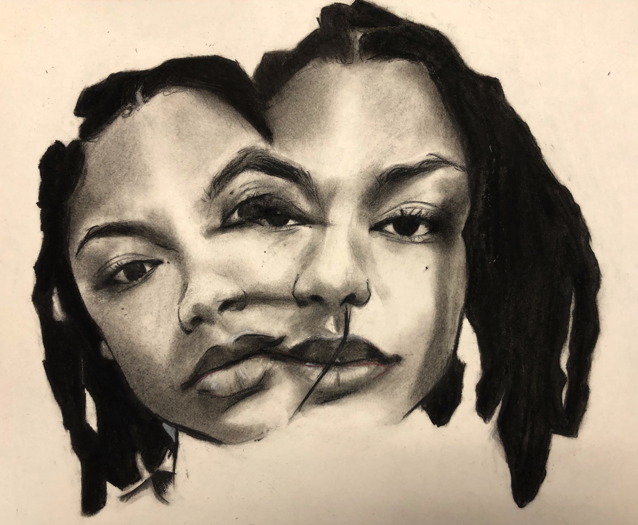
Initially, I limited myself to use black and white charcoal in order to make the person’s skin look smooth and realistic. The charcoal allows me to add contrast as well as form to emphasize the depth and realism of the image.

Slide 4
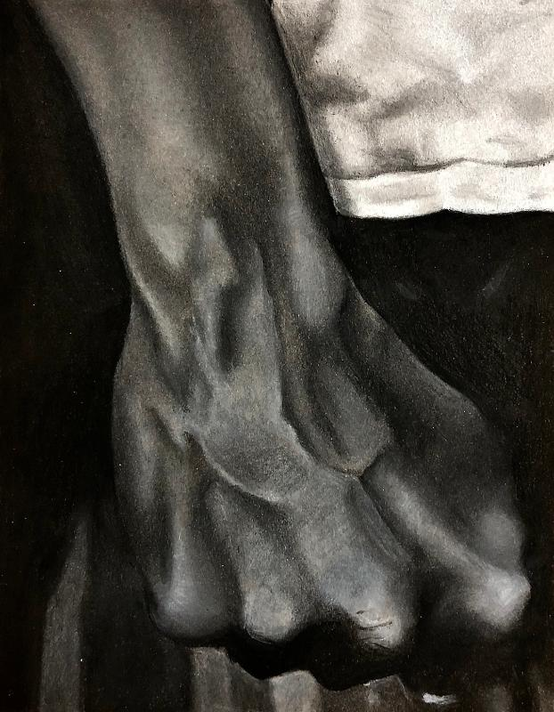
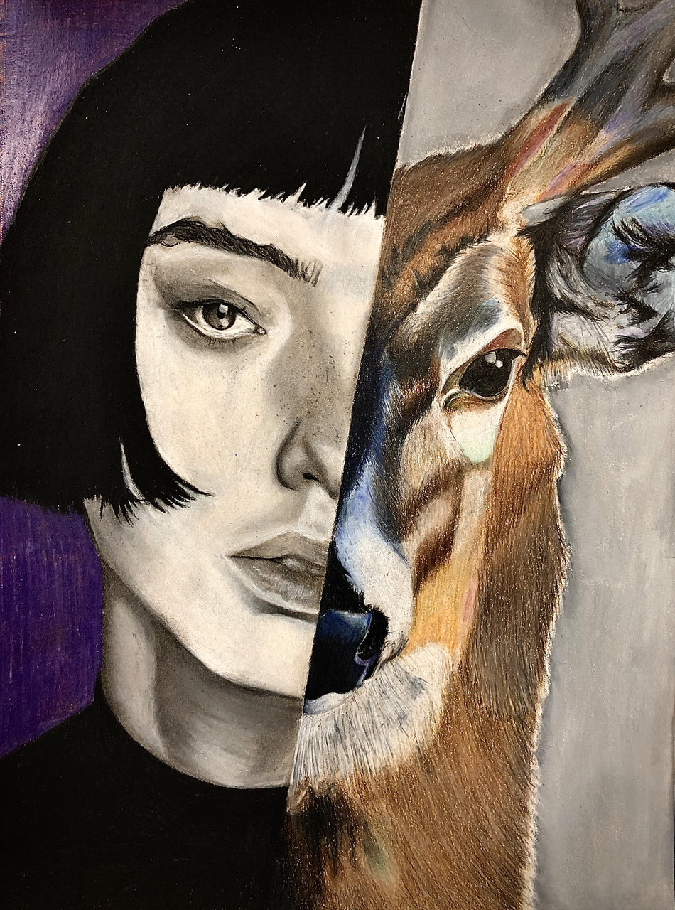
As I developed my investigation I began incorporating Prismacolor colored pencils to highlight sections and to add a little emotion to the work. When working with the colored pencils I focus on using vibrant colors to really emphasize the image.

Slide 5
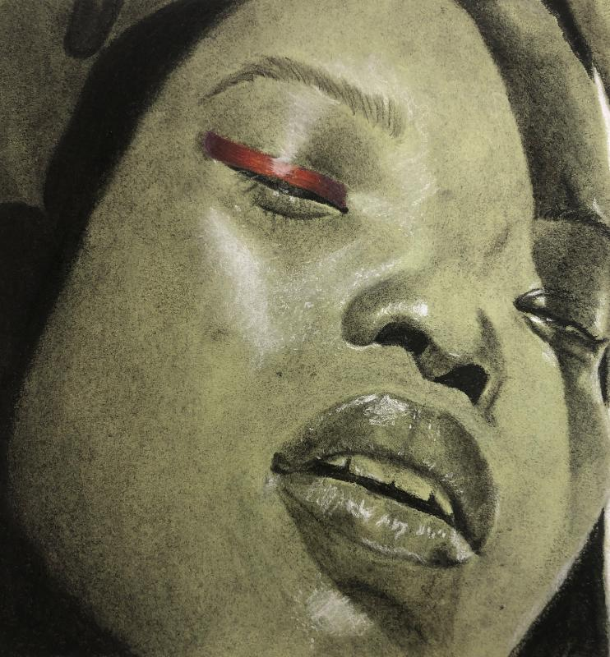
One artist who influenced the direction of my artwork was Jenny Saville. I used her sketches as a reference because I liked how she contrasted the skin with the charcoal and how she did a kind of a merge effect with the faces from one position to another. Also, Saville’s work really motivated me to want to create more works that include different body types.

